Slide 1
EngTechNow: A case for change
June 2014

Slide 2
What is EngTechNow?
EngTechNow is a new campaign supported by the three largest professional engineering institutions (IET, IMechE and ICE). It aims to:
Raise the profile of Engineering Technicians
Grow the number of EngTechs to 100,000 by 2020
Encourage major employers and FE Providers to support growth
The initiative is supported by government and funded by Lord Sainsbury’s Gatsby Foundation.

Slide 3
What are the benefits of EngTech for FE Providers?
Attracts employers to place their apprentices with the FE provider by demonstrating their support for professional registration;
Growing focus on professional registration across the engineering industry;
Demonstrates that an FE provider supports high professional standards within engineering;
Apprentices have support to achieve professional registration from both their FE provider and employer;

Slide 4
What are the benefits of EngTech for employers?
Growing focus on professional registration across the engineering industry;
Highlights an organisation’s high professional standards;
Can help to recruit and retain the best people as well as contributing to a competitive edge in bidding for new contracts;
Can provide a benchmark for an organisation’s learning and development programmes, with UK-SPEC as an internationally-recognised underpinning standard;
Talent development – provides a practical way to grow talent, using EngTech as the first stepping stone towards IEng and CEng.

Slide 5
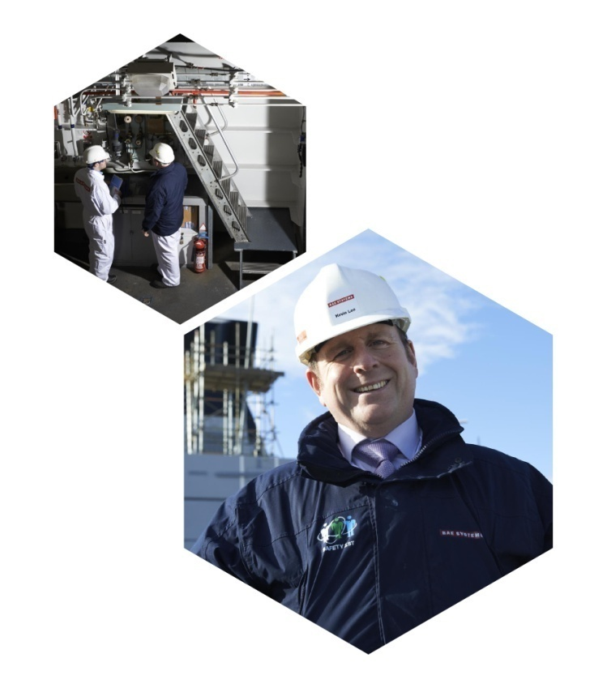
What are the benefits for Technicians?
Demonstrates that individuals meet a benchmarked standard;
Recognises competence and commitment in engineering;
Marks registered technicians out as professionals;
Provides a clear route into and through engineering;
Allows registered technicians to stand out from their peers when applying for internal and external job roles.
Added to these are the benefits provided by membership of a professional body.

Slide 6
What you can do…
Champion professional registration among your apprentices – You work with apprentices everyday and have a powerful influence on whether they will register;
Work with employers and the PEI’s to embed Engtech into the curriculum so apprentices can achieve Engtech upon qualification;
Comms & PR: Support the initiative internally & externally;

Slide 7
What we can do…
Train individuals within your organisation at no cost to become EngTech advisors to support other potential EngTechs through registration;
Run events and workshops to raise awareness of EngTech and support your apprentices in registering;
Provide marketing collateral free of charge for you to have on site;

Slide 8
Who else are we working with?
EngTechNow Champion Employers Leadership Engaged | EngTechNow Champion Employers Engaging Leadership | EngTechNow Ambassadors (engaged through Crossrail) Leadership Engaged | FE Providers & Awarding Bodies
1. Crossrail | 1. National Grid | Atkins | NFEC
2. E.ON | 2. Airbus | Arup | Pearson Education
3. Network Rail | 3. QinetiQ | BAM Nuttall | Stephenson College
4. Rolls Royce | 4. Shell | Mouchel | JTL Training
5. BAE Systems | 5. HS2 | Costain
6. Thames Tideway | 6. Amey | Balfour Beatty
7. NG Bailey | 7. Doosan | Kier Group
8. Siemens

Slide 9
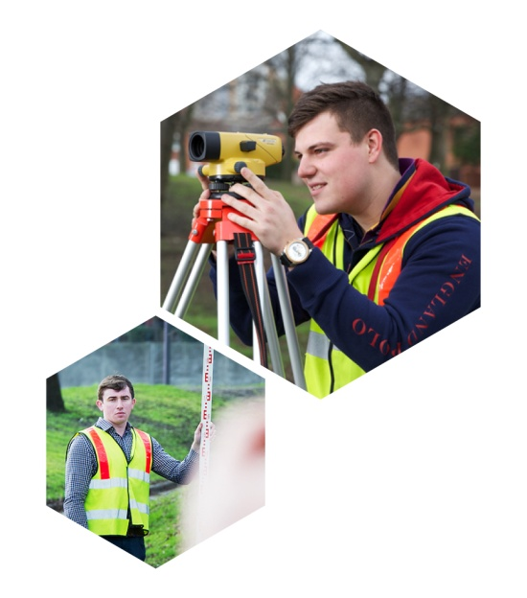
Contact details
Phil Horsham (Project Manager):
philip.horsham@engineeringtechnician.org.uk
www.engtechnow.com
@EngTech_Now

